Slide 1
Value Added Taxation: Mechanism, Design, and Policy Issues
Tuan Minh Le

Slide 2
PRESENTATION OUTLINE
I. VAT: An Introduction
II. Design Issues and Policy Implications
III. Basic Measurement of VAT Efficiency.
IV. Conclusion

Slide 3
1. Why VAT
I. VAT: An Introduction
To replace existing unsatisfactory indirect taxes such as turnover or single-stage taxes
To raise revenues (potentially, a buoyant tax).
To achieve economic efficiency.

Slide 4
2. Value added and alternatives in VAT computation
I. VAT: An Introduction (Cont’d)
Value added
VA = wages to labor + profits to owners of production factors. Or,
VA = value of output - value of inputs.

Slide 5
I. VAT: An Introduction (Cont’d)
Three alternatives in VAT computation
Method | Tax liability
(1) Addition | (t₁*wages) + (t₂*profits)
(2) Subtraction | t*(Poutput – Pinput)
(3) Invoice-based credit ( or credit method) | t1*Poutput – t2*Pinput

Slide 6
I. VAT: An Introduction (Cont’d)
Relative advantages of credit method
- Problems with addition and subtraction methods.
- Credit method:
(1) The ease of using multi-rate structure;
(2) Enforcing businesses to keep invoices and hence, facilitating the auditing (‘self-policing’).

Slide 7
3. The most common VAT base
I. VAT: An Introduction (Cont’d)
Consumption type
Intermediate inputs and investment items excluded.
Base similar to the one in consumption tax (VAT equivalent to retails sales tax in terms of revenue collection, if properly applied).

Slide 8
4. VAT calculation (credit method)—an example
Producing bread. Three stages: Farmer-Miller-Baker-Bread Consumer. P₁, P₂, P₃ price of wheat, flour, and bread. t₁, t₂, and t₃ respective VAT rates.
No exemption, no zero rating
Tax liability = t₁*P₁+[t₂*P₂-t₁*P₁]+[t₃*P₃-t₂*P₂] = t₃*P₃
Exemption
Exemption of the first stage
Tax liability = t₂*P₂+[t₃*P₃-t₂*P₂] = t₃*P₃
Exemption of the second (middle) stage
Tax liability = t₁*P₁+t₃*P₃
Exemption of the third (last) stage
Tax liability = t₁*P₁+[t₂*P₂-t₁*P₁] = t₂*P₂

Slide 9
5. VAT calculation (credit method)—an example (cont’d)
Zero rating
Zero rating of the first stage
Tax liability = t₂*P₂+[t₃*P₃-t₂*P₂] = t₃*P₃
Zero rating of the second (middle) stage
Tax liability = t₁*P₁+[0*P₂-t₁*P₁]+[t₃*P₃-0]=t₃*P₃
Zero rating of the third (last) stage
Tax liability = t₁*P₁+[t₂*P₂-t₁*P₁]+[0*P₃-t₂*P₂]=0

Slide 10
II. Design Issues and Policy Implications
1. Exemption
Why common practice
Equity rationale.
Better option, economically and administratively, than zero rating or reduced rates.
Administratively, cost-effective to exempt hard-to-tax sectors (to be discussed further).
Problems
Cascading or shrinking base.
May be ineffective.
May be inefficient.
Apportionment of input values required for firms producing both exempt and taxable outputs.

Slide 11
II. Design Issues and Policy Implications (cont’d)
2. Treatment of hard-to-tax sectors
Financial sector
- Technically hard to evaluate value added, while revenues potential low.
- Common practice: Exempt—except for certain types of fee-based services such as brokerage and safe-keeping.
- Some experiment in taxing the sector, such as quasi-VAT on basis of addition method.

Slide 12
2. Treatment of hard-to-tax sectors (cont’d)
Agriculture
Hard to tax due to multiple—and ‘compelling’—technical, social, and political reasons.
Common practice: exempt, but derivative problems stemmed from needs to exempt/or zero rate agricultural inputs.
Practical fix (?): Bring sector to tax net, while applying threshold to exempt small farmers. If continue exemption of agriculture, strictly limit number of exemptions to inputs exclusively used for agriculture (fertilizer and seeds).

Slide 13
2. Treatment of hard-to-tax sectors (cont’d)
Small traders
- High compliance and administration costs; therefore, need to exempt.
Common practice:
- Setting threshold, but also very complex task.
- Also, allowing for voluntary registration (but controversial).
Practical fix (?)
- Setting threshold critical! (Level of threshold determined by tax administration capacity and record-keeping ‘culture’ by taxpayers.)
- Threshold to be uniform across sectors and specified in terms of turnover.
- Start a VAT with high threshold and lowering later (opposite to commonly observed practices).

Slide 14
2. Treatment of hard-to-tax sectors (cont’d)
Housing
- Taxing office buildings/rent, but exempting residential buildings, rent, and sales of existing dwellings.
- However, exempting resale of residential buildings, while taxing new housing would generate unfair windfall gains to owners of old houses.
- Some countries applying transfer taxes, but problems involving cascading effect, while revenue potential low.
- Cnossen (1995) favors neutral application of VAT to real estates (building activities, forms of leasing, and sales—all subject to standard rates).

Slide 15
II. Design Issues and Policy Implications (cont’d)
3. Rate structure
Multiple rate structure inherently complex and rasing both compliance and administration costs.
Still applied on both efficiency and equity grounds.
Contrasting tendencies in developing and developed worlds (Developing countries: More than half base subject to reduced rates. Developed countries: More than 2/3 of base subject to standard rate).
Multi rate structure ineffective in solving equity issues (even unintentionally make problem worse).
Standard advice: Single positive rate, zero rate exclusively applied to exports, and few exemptions.

Slide 16
II. Design Issues and Policy Implications (cont’d)
4. Regressivity
- Being an indirect tax, regressive (with regressivity defined on basis of tax burden in total annual income).
- Other considerations:
(1) Main purpose of VAT;
(2) Regressivity of VAT compared to the one of alternative indirect taxes;
(3) Efficient and effective pro-poor fiscal policies.

Slide 17
II. Design Issues and Policy Implications (cont’d)
5. Refunds
- Critically important for an efficient and pure consumption-based VAT.
- Why common delay in refunds: (1) inefficient processing of refunds, exacerbated by common frauds; (2) incentives for meeting revenue targets; (3) problems for treasury during budget crunching.
- No unique pattern in refund treatment. Most cap refunds at level of VAT on output and remaining balance allowed to be carried forward.

Slide 18
II. Design Issues and Policy Implications (cont’d)
5. Refunds (cont’d)
Practical fix(?)
- Efficient programs for processing refunds for exporters (gold/silver scheme combined with randomized sampling in auditing, for example).
- Smooth cooperation between tax and customs agencies.
- Tax regime: Severe penalty for fraud combined with mandatory time limit for refund.

Slide 19
II. Design Issues and Policy Implications (cont’d)
7. VAT in small countries
- Empirically, VAT productivity higher in small countries and islands.
- Correlation, however, may not be unique to VAT. (Generally, indirect taxes (trade tax, VAT, or excise) tend to be more efficient in small countries relying more on trade.)
- VAT a good option when
(1) economy has domestic manufacturing base with multiple production stages or has distribution stage generating significant value added; or
(2) country has sufficient growth potential for domestic manufacturing.

Slide 20
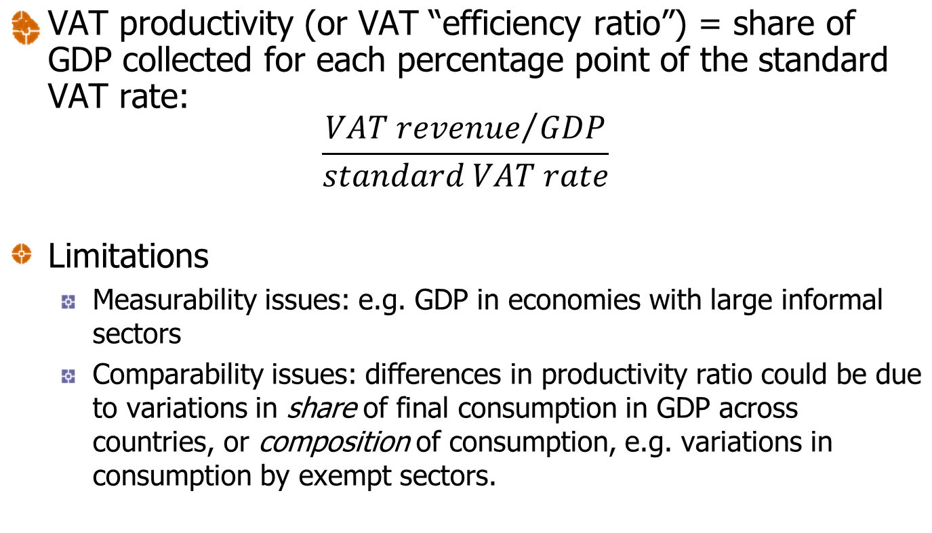
Efficiency
III. Basic Measurement of VAT Efficiency

Slide 21
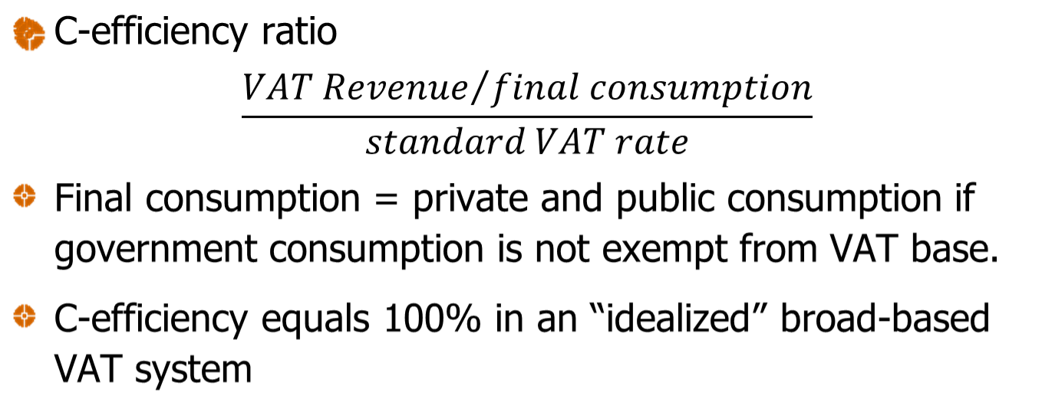
Efficiency (cont’d)
III. Basic Measurement of VAT Efficiency

Slide 22
III. Conclusion
- Keep rate structure simple, broaden base.
- Be careful with ‘pro-poor’ VAT regime with multiple exemptions, zero rates, or multi-rate structure. This is not as efficient as keeping the VAT simple, buoyant, while targeting poverty in more comprehensive approach (combined with income taxation and pro-poor expenditures).

Slide 23
References
Ebrill, Liam et al. 2001. The Modern VAT. IMF.
Le, Minh Tuan. 2003. Value Added Taxation: Mechanism, Design, and Policy Issues.
Le, Minh Tuan, Robert Ebel and Alan Tait. Value Added Taxation, National, in Cordes, Joseph and Robert Ebel and Jane Gravelle, Eds, The Encyclopedia of Taxation And Tax Policy (Washington, DC USA: Urban Institute Press, 2005).
.<number>

